Slide 1
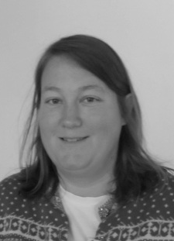
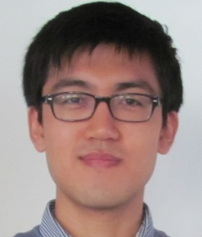
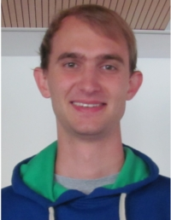

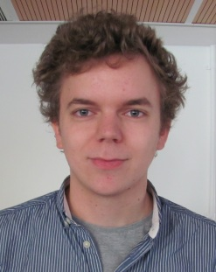





Group D Phase 2 Project
A. Ambuehl | W. Smith
J. Leem | O. Thomas
M. Lücken

Slide 2
The Problem – Human Immune Response Modelling
The human immune system is a complicated entity
The model of Hancioglu et al. (2007) seeks to capture some of its behaviour…
… specifically the interplay between innate and adaptive immunity
Group G (Pearce et al.) were tasked with implementing model in MatLab®

Slide 3
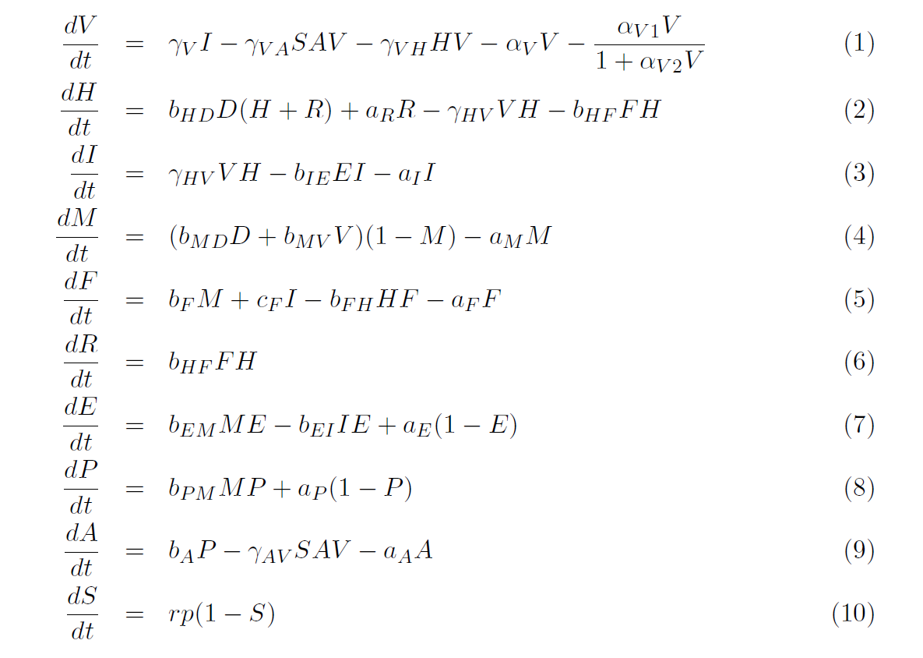
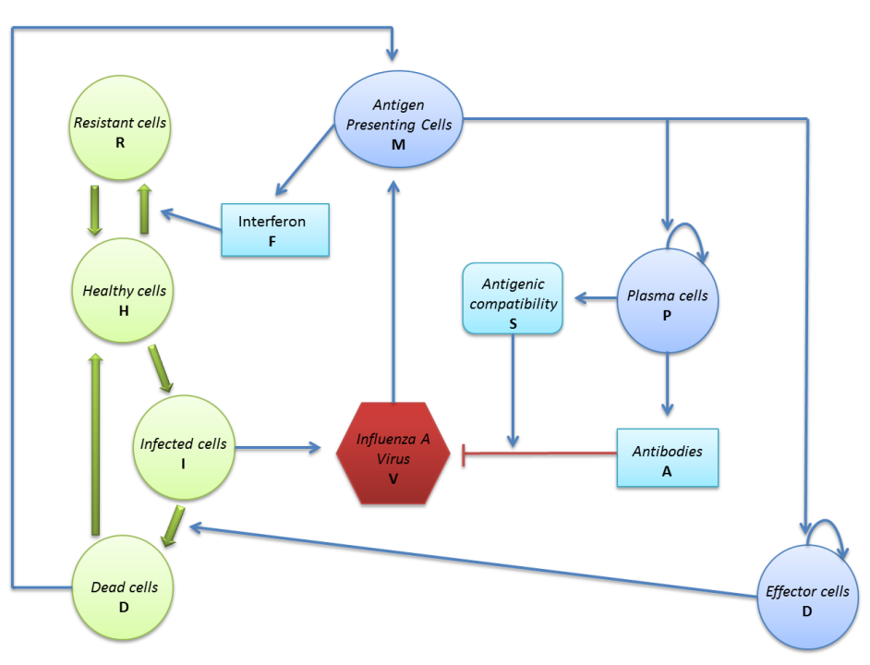
The Hancioglu model

Slide 4
Phase 2 – Inherited Code
So, how did they do?

Slide 5

Inherited Material - Checklist
What | Check | Comments
Clear report? |  | Well-explained mathematics and good documentation of results. Authorship clear.
User-friendly GUI? |  | Beautiful GUI. Drop-down menus are a good solution to the multi-parameter problem. Needs a ‘running ’ bar and a reset key.
Clear Licencing? |  | Yes, throughout. Immaculate spelling of CC-BY-3.0. We all felt thoroughly safe.
Code Commenting? |  | Quite thorough. Autocomments left by GUIDE of dubious value.
Code Structure? |  | Clear, well structured, but incorporation of new variables proved difficult, owing to GUIDE’s heavily nested data stream.

Slide 6
Phase 2 Modifications
Introduction of Stochasticity
In both Matlab (Owen) and C Mex Files (Malte)
Addition of Drug Response
Will, Antonietta
Refinement of Biological Accuracy of Model
Jin
Incorporation of new features into GUI

Slide 7
Extensions 1
Stochastic modelling

Slide 8
Stochastic modelling
We established two points at which adding stochastic noise would be biologically justified
Production rates of virus from infected cells
Variation in burst size is known to be significant (Mitchell et al. 2011)
Affinity Maturation process will be stochastic in nature
Selection of most successful antibody from series of candidates (Grimaldi et al. 2005)

Slide 9
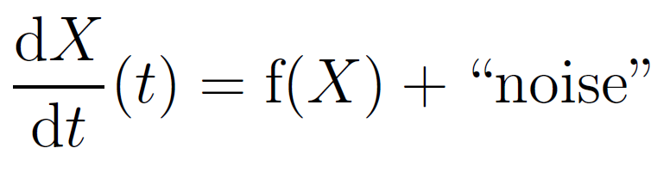
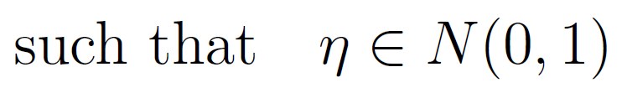
Adding noise to populations
Add noise into population ODE
Adapt Euler method to give Euler-Maruyama method
f(X) is the “drift function”
G(X) the “diffusion function”
δt is the timestep

Slide 10

Adding noise to rates
Alternatively, we can add noise to specific processes
This demands adding of noise functions within the drift function f(X)
We can adapt regular ODE solver:

Slide 11
Implementation in Matlab®
These two approaches were coded into two separate solvers in Matlab
Noise function encoded such that:
Allows for a wide range of noise types
Zero-checking necessary to avoid highly divergent areas of phase space
Code ran fast enough for parameter testing

Slide 12
Stochastic Matlab® Results
Adding noise to affinity maturation rate had little appreciable effect on other outputs
It only really functions as a Boolean, anyway.
Adding stochasticity to virus production produced some exciting results
Brings about the possibility of several waves of infection.

Slide 13
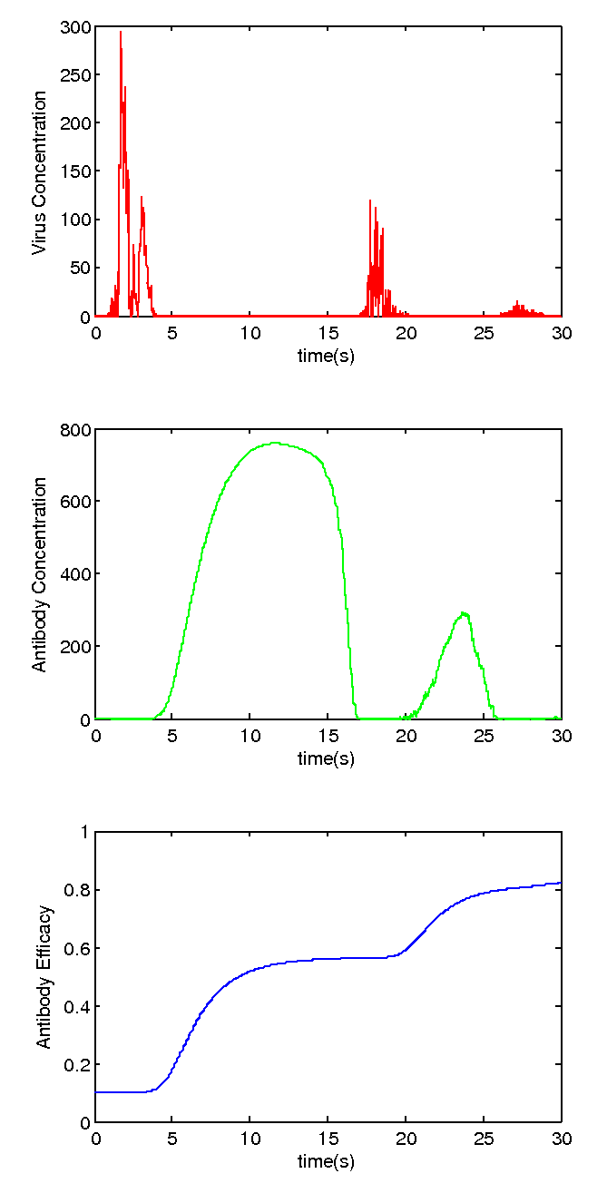
Multiple Waves
Noise in V allows infection to re-emerge when antibody count decays away
Antibody Efficacy grows each time
Population “remembers” how to fight disease, finding it easier to rebuff

Slide 14

C Implementation in Mex function
C implementation of the stochastic solver used the Euler-Maruyama method with a Box-Mueller algorithm to generate Gaussian Variables:
# of Iterations | C Code Runtime (s) | Matlab Code Runtime (s) | Speedup Factor
1000 | 0.0016 | 0.0516 | 32.25
3000 | 0.0045 | 0.1550 | 34.44
10000 | 0.0147 | 0.5130 | 34.90
100000 | 0.1480 | 5.1298 | 34.66

Slide 15
Extensions 2
Antiviral Drug Treatment

Slide 16
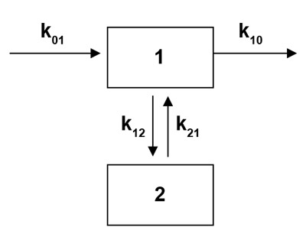
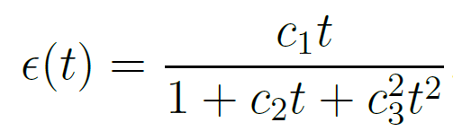
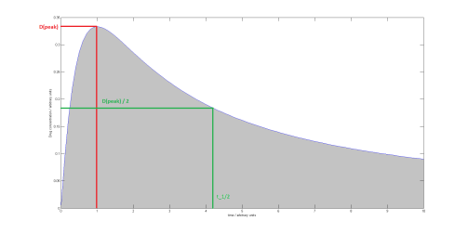
Extensions 2: Influence of antiviral drugs
A number of papers have discussed the inclusion of drug variables in human virus response (e.g. Smith and Perelson 2011…)
Approach 1: 2-compartment
pharmacokinetic model
(adds extra ODEs to describe drug variables )
Approach 2: Analytical expression for drug effects (avoids passing extra variables through a complex data structure)
Notes:
The question here is how to represent the change in drug concentration as a function of time. The drug is moving in to the tissues from the bloodstream, having been converted into its active form in the liver. Simultaneously, the drug is being removed from the bloodstream by the kidneys. The balance of the two effects tends to produce a characteristic profile – fast influx followed by slow, exponential purge.

Slide 17
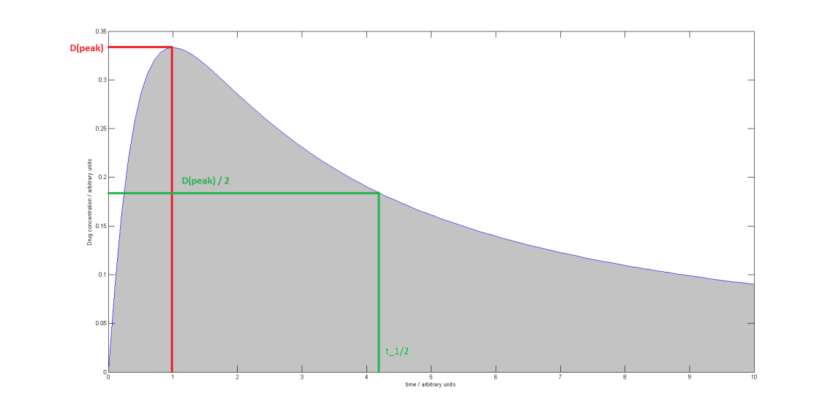
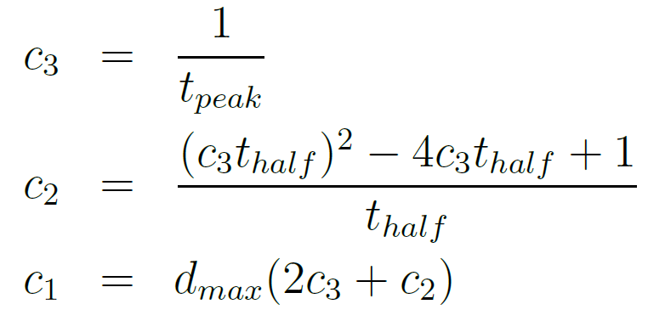
Extensions 2: Influence of antiviral drugs
3 extra parameters for the drug expression
These can be related to empirical pharmacokinetic data, viz
A fourth parameter was introduced to control the time of administration (curve x-offset)

Slide 18
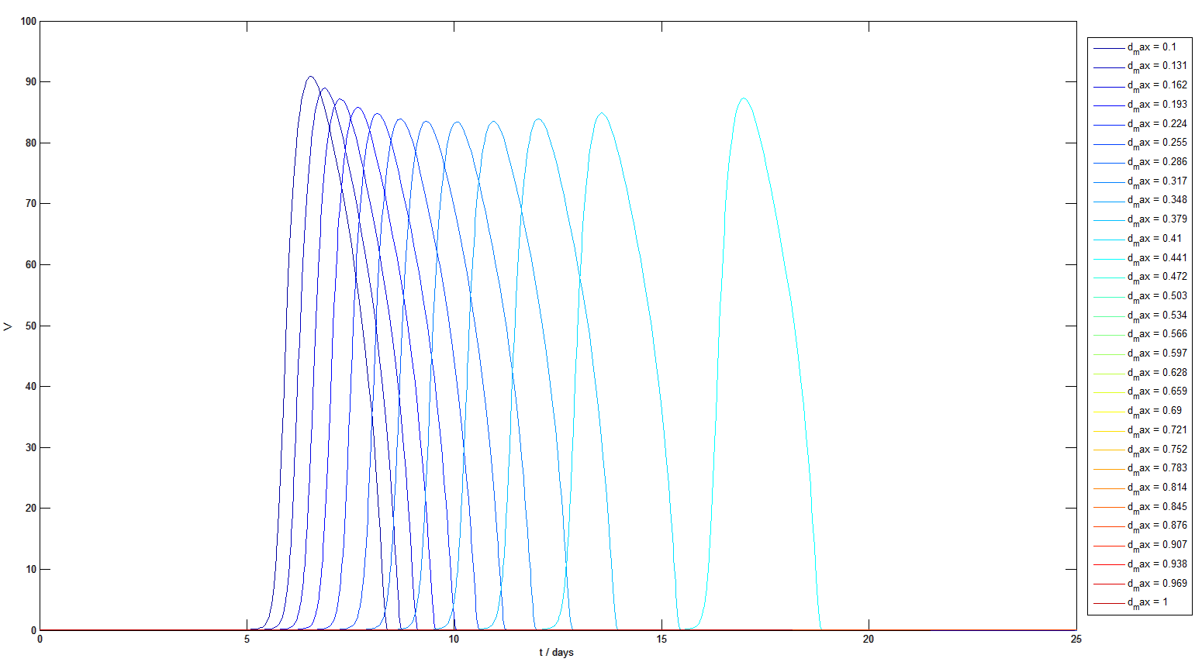
Extensions 2: Drugging – some results
Increasing drug dose delayed onset of viral peak, ultimately removing it:
Virus Population
time / days
t_{max} = 3, t_{1/2} = 8, t_{offset} = 0, 0.1 < D_{max} < 1

Slide 19
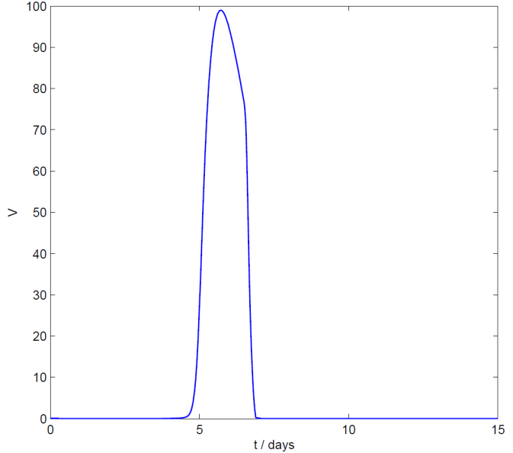
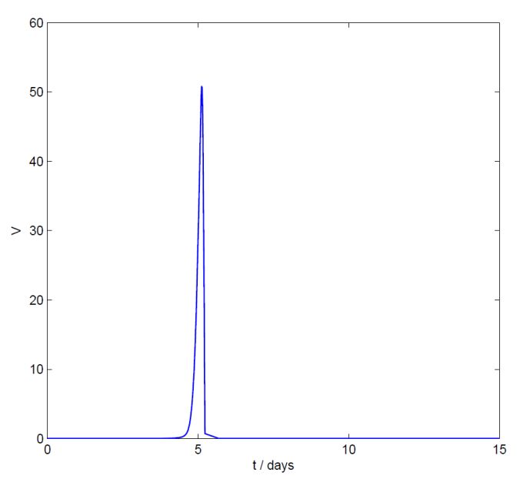
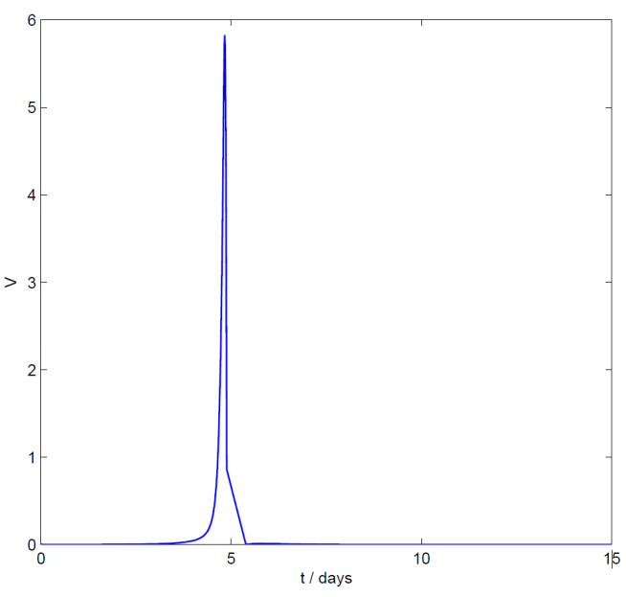
Extensions 2: Drugging – some results
Time of administration can be critical to treatment outcome:
Full Infection
Intermediate
Suppressed
t_{offset} = 6.5 days
t_{offset} = 5.1 days
t_{offset} = 4.8 days
Catch the infection early and it has less time to develop

Slide 20
Extensions 3
T cell : B cell interactions

Slide 21
Addition of T:B cell dynamics
A fundamental process in plasma cell production is the interaction of helper T cells (T_{FH}) and B cells
This has been omitted in the original model
TCR
BCR
CD40L
CD40
Cytokines

Slide 22
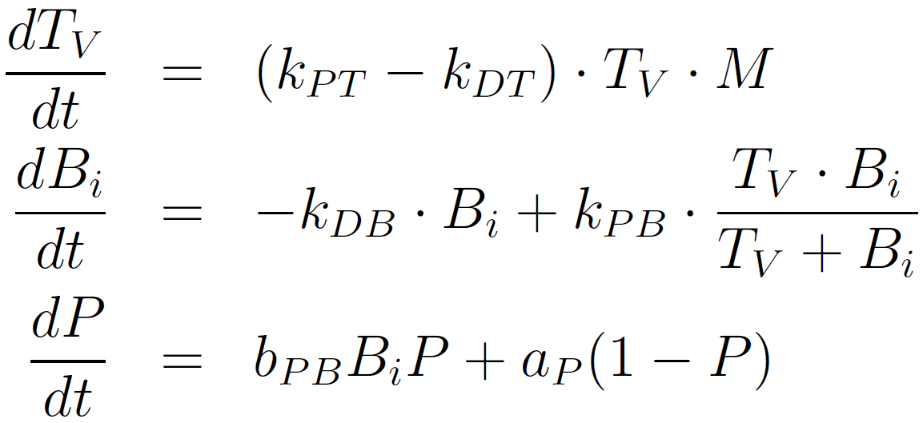
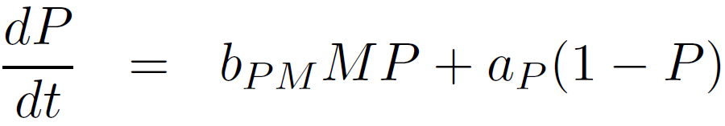
Adding two compartments:
The two compartments are placed downstream of the antigen-presenting cell (M) but upstream of the plasma cell (P):
M
T_{FH}
B
P

Slide 23
How is this added out of the blue?
Carneiro’s group (1996) modelled the interaction of T cells and B cells against antigen challenge.
We have modified the simplified T cell equation to be dependent on APCs, and the plasma cell equation is now dependent on B cells, rather than APCs:
* The constant b_{PM} has just been renamed to b_{PB} to avoid confusion. They both represent plasma cell synthesis

Slide 24
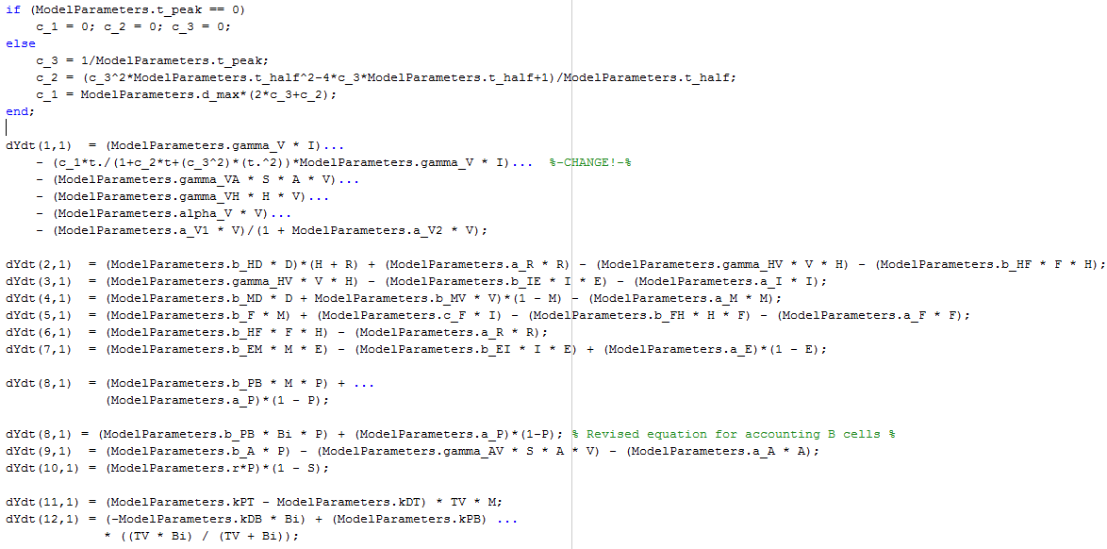
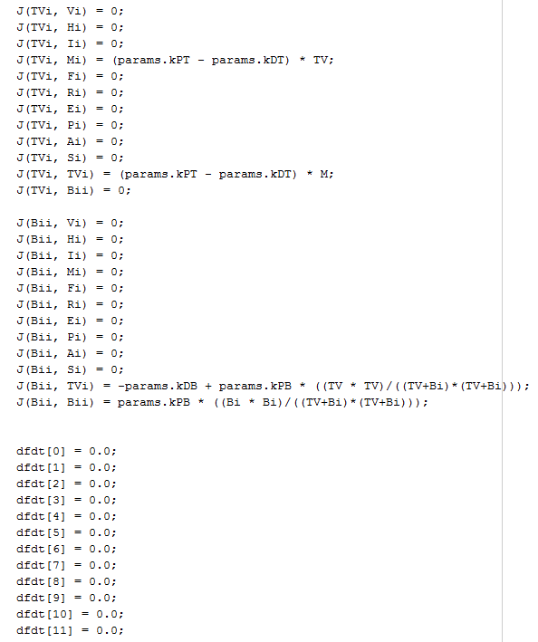
In code, this means…
Given our code, the following changes were implemented to accommodate for the two new compartments:
More equations on MATLAB ODE solver
Corrections and aditional entries for Jacobian matrix on MEX solver

Slide 25
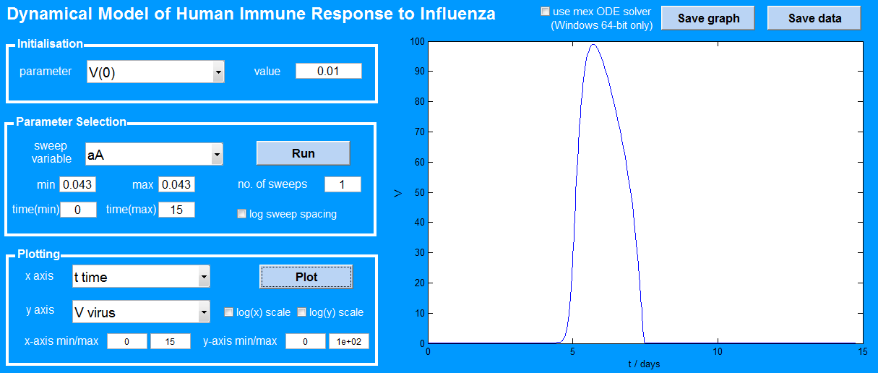
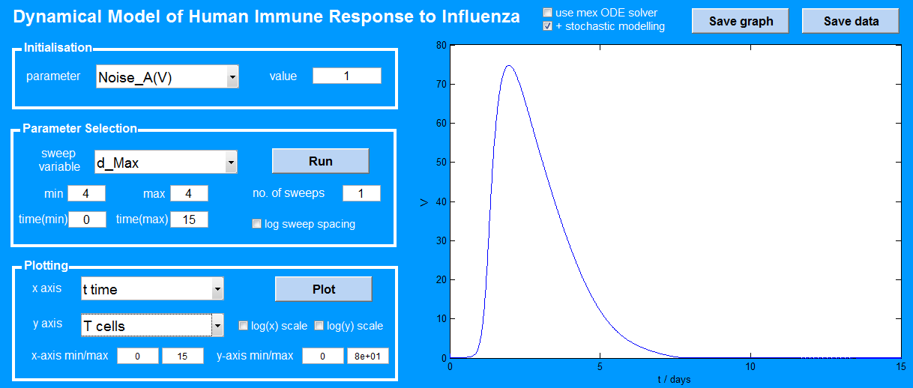
Old vs. New GUI
Much of the interFACE is the same
More options and customisation

